Slide 1


Natural Language Processing with ML
Research Intern : GARVIT GOPALANI
Manipal Institute of Technology
Supervisor : PROF. VIRENDRA SINGH(IITB)
4th semester

Slide 2
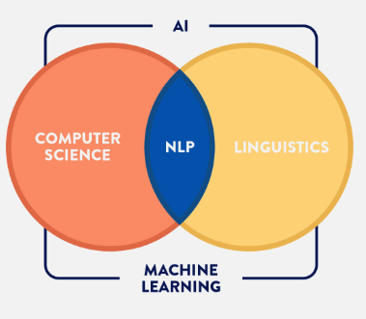
INTRODUCTION
NLP is a field of machine learning and linguistics concerned with the interactions between computers and natural languages.
Sentiment Analysis
Sentiment analysis is a NLP and information extraction task that aims to obtain writer's feelings.
It defines a person's attitude towards a topic or an association.

Slide 3
PROJECTS
Sarcasm Detection
In order to correctly understand people’s true intention, being able to detect sarcasm is critical.
Sentiment Change analysis on real time twitter data
Understanding change of sentiments among twitterers based on their tweets.

Slide 4
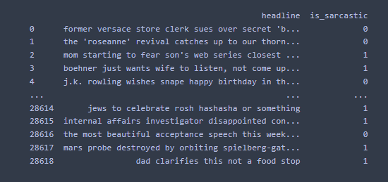
Datasets
Sarcasm Detection
In Sarcasm detection we will be using a dataset consisting a number of headlines with corresponding labels identifying if the headline is sarcastic or not

Slide 5
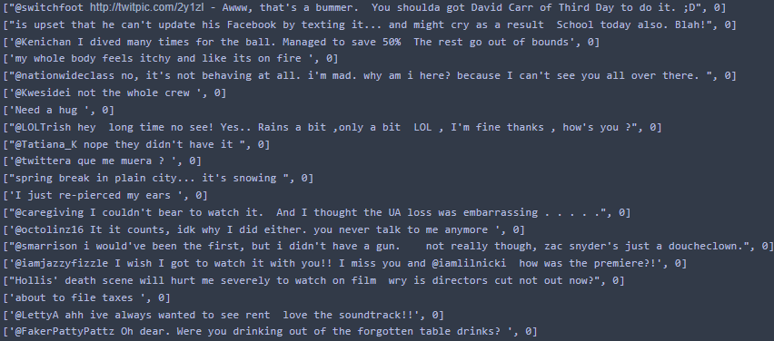
Datasets
Sentiment Change analysis
In this dataset we have a collection of 16 million tweets which have a corresponding label stating
If the tweet was positive or negative.

Slide 6


Data Pre-processing in Machine learning
Why do we need Data Pre-processing?
The real-world data available to us is very dirty and difficult to train our Machine learning model. Therefore, for a model to be accurate and precise in predictions is that the algorithm should be able to easily interpret the data's features.

Slide 7
Data Pre-processing in NLP
Steps:
Lower Casing the sentences
Removing URLs, emoticons and punctuations
Replacing Contractions
Removing all stop words(example could, should, over etc.)
Tokenization
Making a dictionary of words
Replacing words with corresponding numbers
Adding padding to the sequences
Splitting the dataset in test and train sets

Slide 8
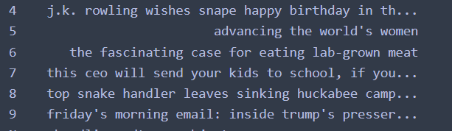
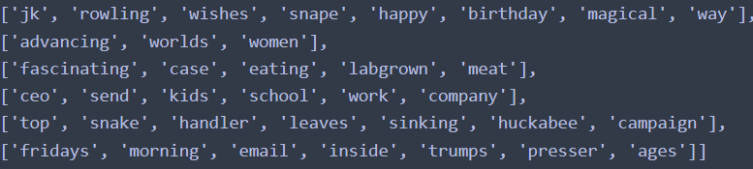

Slide 9
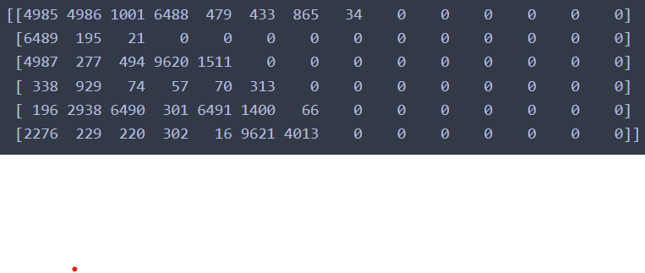

Slide 10
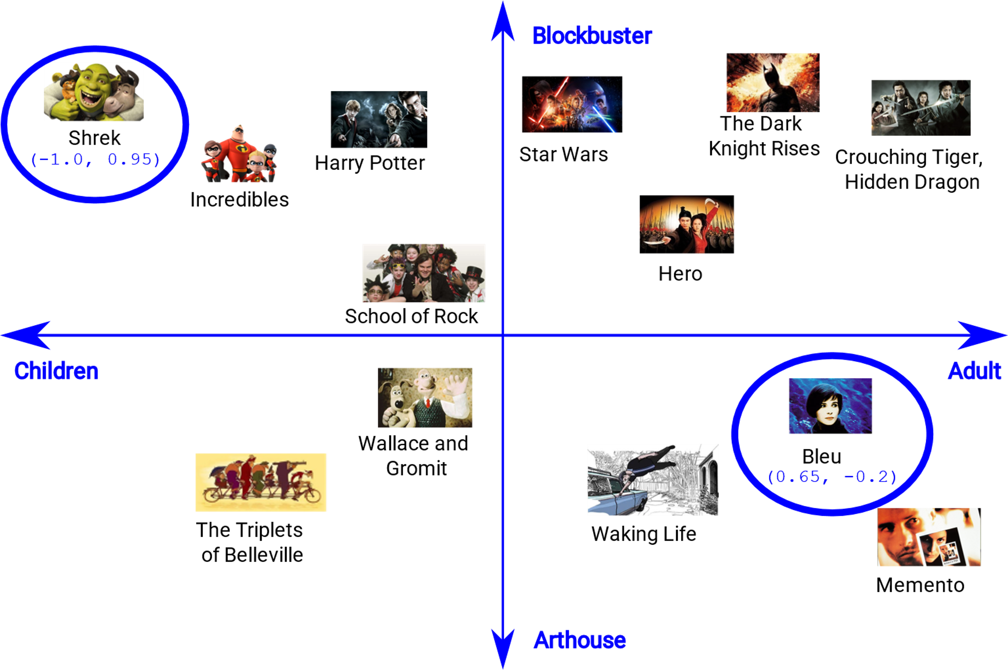
EMBEDDINGS IN MACHINE LEARNING
An embedding is a relatively low-dimensional space into which you can translate high-dimensional vectors.
Embeddings make it easier to do machine learning on large inputs like sparse vectors representing words. Ideally, an embedding captures some of the semantics of the input by placing semantically similar inputs close together in the embedding space.
An embedding can be learned and reused across models.

Slide 11

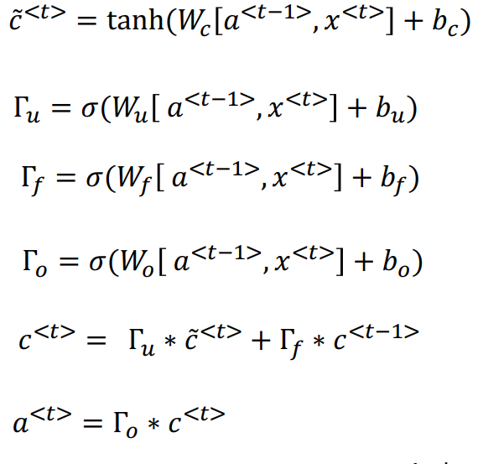
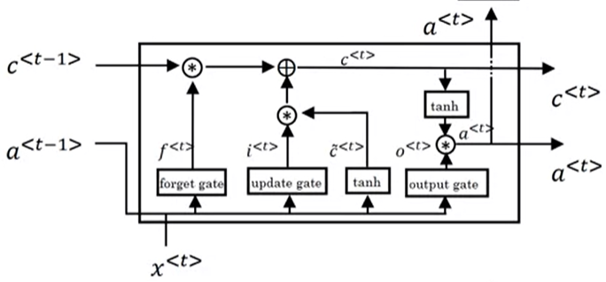


LONG SHORT-TERM MEMORY UNITS(LSTM)

Slide 12
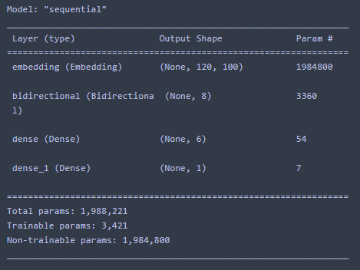
SARCASM DETECTION MODEL
3 hidden layers used.
First is Embedding layer followed by a bidirectional LSTM layer.
Dense layer with relu activation function.
The final layer is another dense layer with sigmoid function as activation

Slide 13

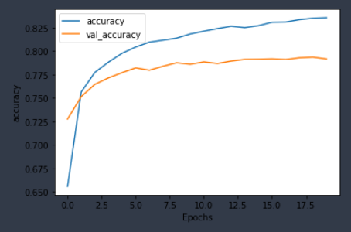
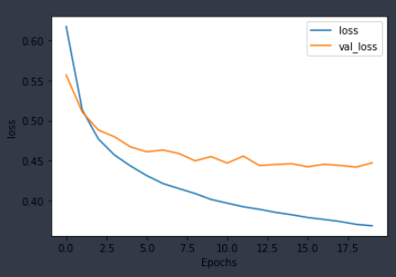
By this we can conclude that our model was able to correctly classify 11,306 sentences out of 13,832 given for testing.

Slide 14
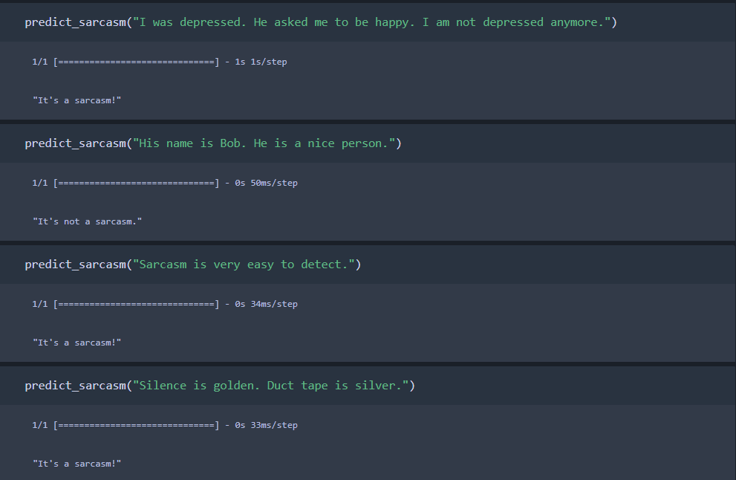

Slide 15
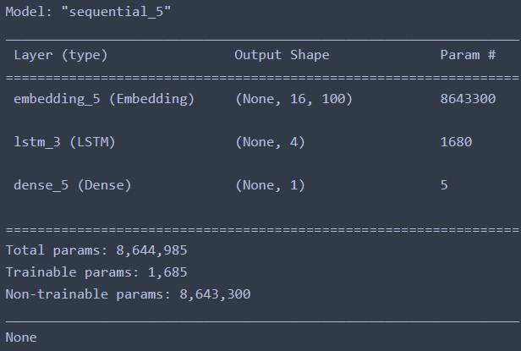
Sentiment analysis model
Since the dataset had 1.6 million tweets to avoid overfitting, we have used only two hidden layer.
One for embedding and other for LSTM.
After this there is a final layer which has a sigmoid activation function

Slide 16
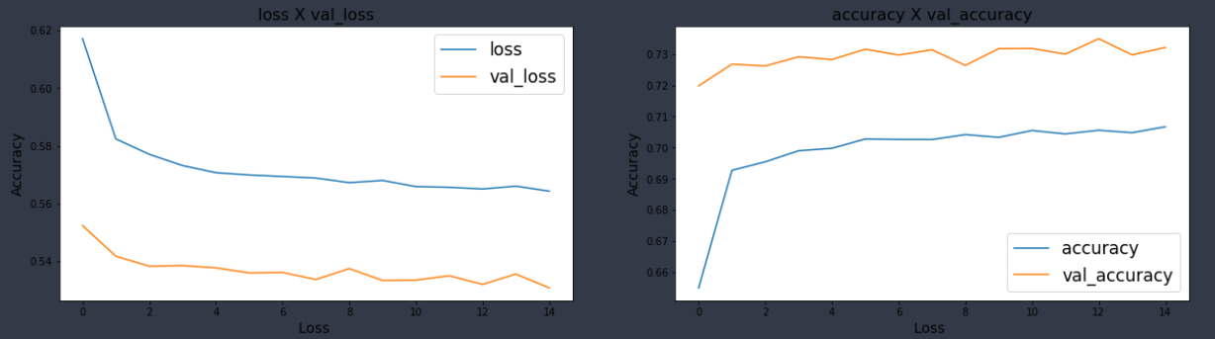

Slide 17
Prediction using ML Model
Now by using this model we have predicted the number of people who spoke in a positive light and negative light on a topic.
The model then used this data to predicted that how many people changed their sentiment towards an association.
Sentiment change is checked by classifying the tweets extracted from twitter into positive and negative.
Usernames are taken form the tweets.
Thus, by using these usernames their previous tweets are analysed and it is predicted if they have changed their point of view or not.

Slide 18
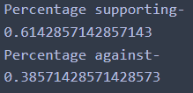
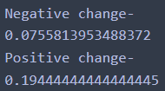
Case Study
The example of Agnipath scheme is taken. In my case study 500 real time tweets are extracted related to the case study from twitter.
The number of people who spoke in favour and against it are shown below.
After this the model is predicting how many people have changed their sentiment after the release of the scheme.
So out of 500, 307 of them have supported the scheme whereas 193 were against it.
The number of people who had negative sentiment change towards government were around 37 and around 97 people supported the scheme even though they criticised the government earlier

Slide 19


